Slide 1









Paris for KIDS
Data Analytics Project
Ironhack
By Xinly Roy

Slide 2

The Inspiration Behind the Project
Becoming a parent transformed my perspective on going out in Paris. Simple outings became challenges as I searched for child-friendly places where I could feel comfortable with my family.
I noticed a lack of clear information on which places are genuinely welcoming to families, especially for parents who want to enjoy Paris without compromising on comfort for their children.
This realization inspired me to create a tool that helps families find child-friendly spots across Paris, making outings easier and more enjoyable for everyone.

Slide 3



The Challenge of Finding Kid’s Friendly Spots in Paris
Paris has thousands of restaurants, parks, and events, but finding locations truly suitable for families is difficult.
While some places are marked as ‘kid’s friendly,’ the label can be misleading, and other great spots aren’t labeled at all.
What if we could use data analysis to predict which places, even without a kid-friendly label, are genuinely welcoming to children?
This project wants to solve these challenges by analyzing real reviews and using machine learning to make accurate, helpful predictions for parents.

Slide 4

The goal of this project…
Making Paris More Accessible for Families

Slide 5
Data collection & cleaning
Flat files
api
Web scraping
My sql
bigquery
Kaggle
OpenData.Paris
Google places API
Google Pytrends
Wikipedia
Liternaute

Slide 6

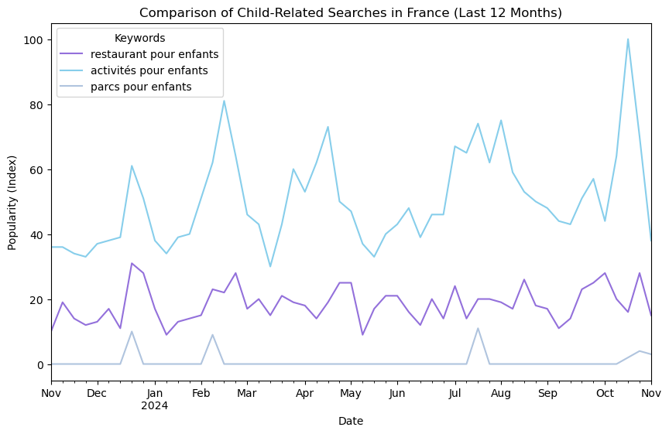
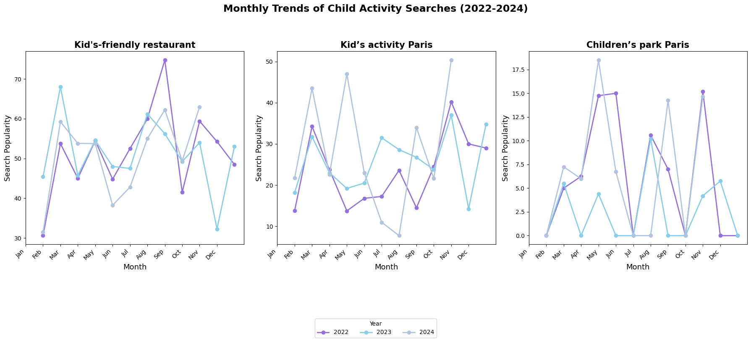
Exploratory data analysis (eda)

Slide 7
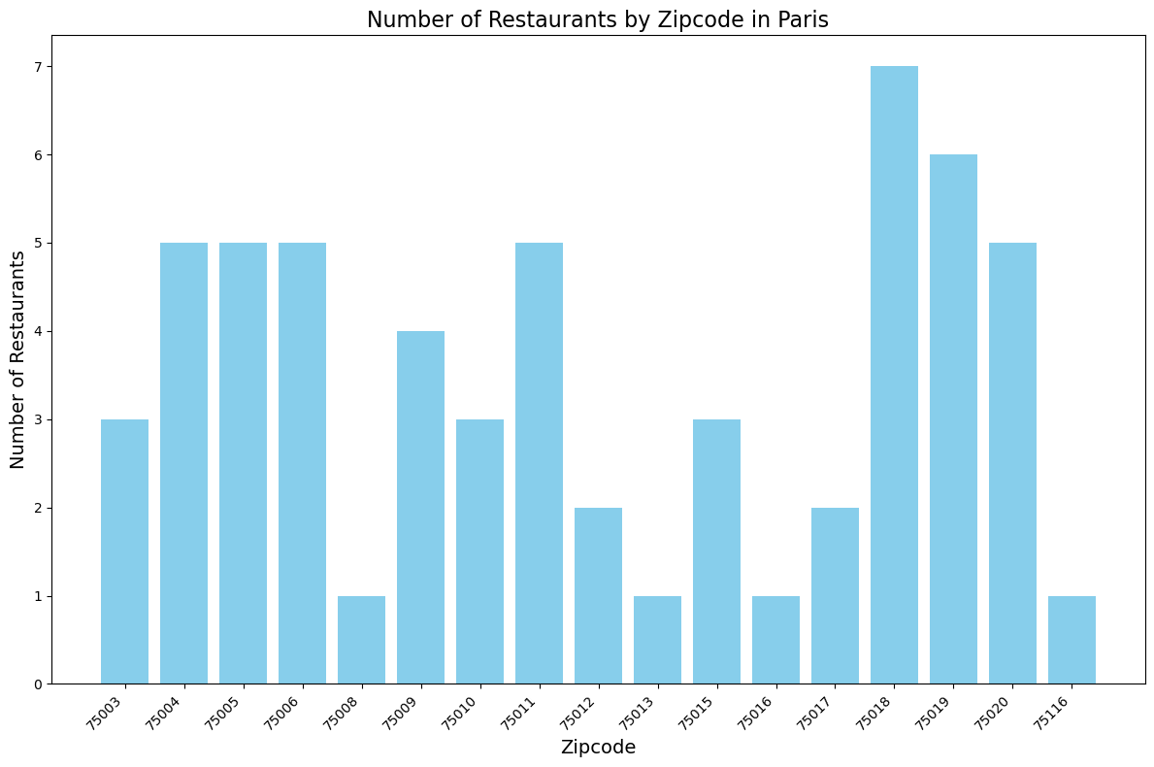
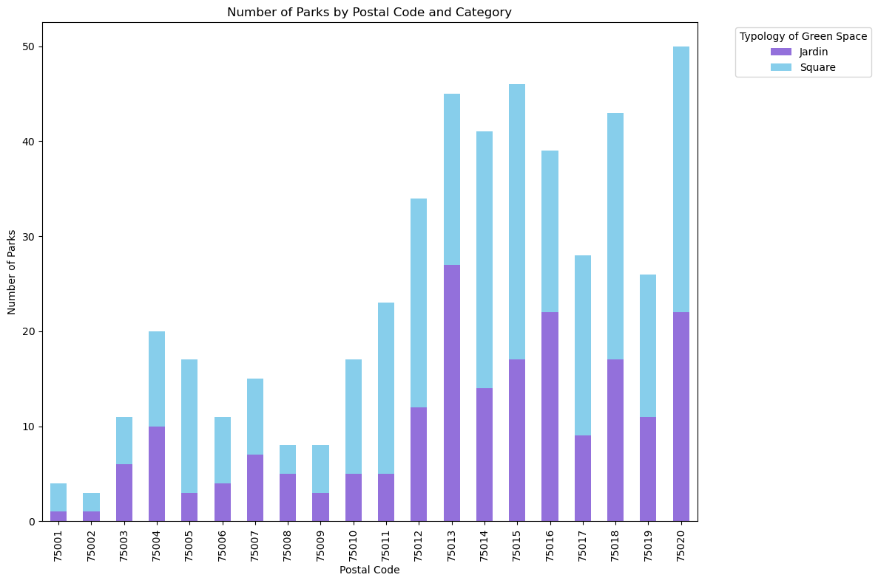


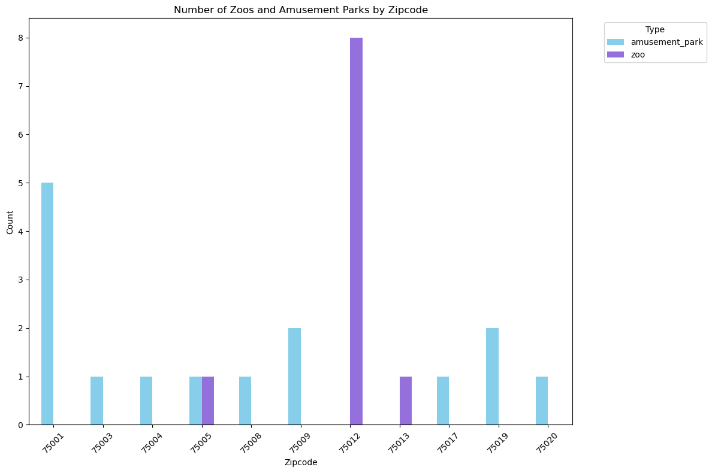
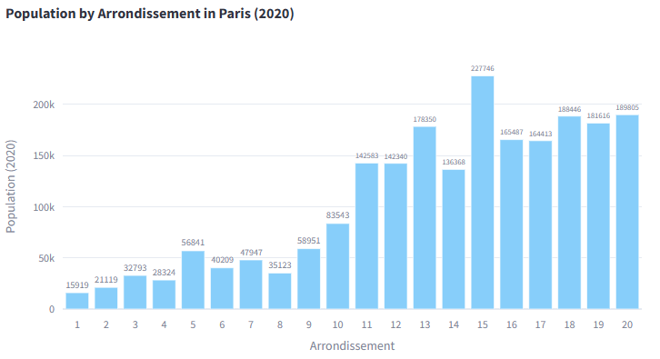

Exploratory data analysis (eda)

Slide 8

Kid’s friendly app
https://kidsfriendlyapp.streamlit.app/

Slide 9


conclusions
Data-driven insights enable tailored recommendations for parents and caregivers, making decision-making easier.
The natural language processing model analyzes customer reviews to predict whether locations are family-friendly, expanding the range of options available.
This tool simplifies planning for families, helping them discover suitable activities and places across Paris with ease.
Through this project, I aim to empower families to enjoy the vibrant city of Paris, creating memorable experiences together.

Slide 10


THANK YOU!
By Xinly Roy

